Slide 1
Call Projection Model BI West Team

Slide 2
Objective & Purpose
The objective of this project was to develop a historically validated call projection model that is usable going forward to project all types of calls.
As of now, we have a fully-working adaptable model which automatically updates each week and can be further customized over time as needed. It also ‘learns’ to re-adjust new projections based on its past misses.
Several functions (~5000 lines of code) and one script which calls these functions to run the model were programmed in ‘R’.

Slide 3
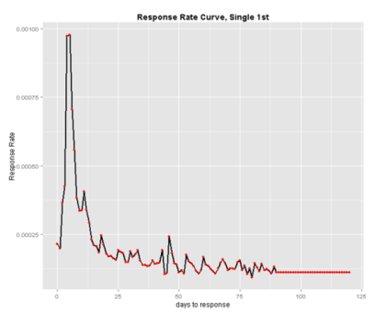
Call Model : Mktg Direct Call Count
Data used: (1) campaign tracker (campaign response) and (2) a call query to derive all past call counts.
4 historical RR curves are built for each ‘class_of_mail’ and ‘rounds’ combination (“Single, 1st”, “Single, 3rd”, “Multiple 1st”, “Multiple 3rd”) by days_to_response.

Slide 4
Call Model: Mktg Direct Call Count
In addition, a separate ‘Latest INQ’ curve is built as ‘Latest INQ’ campaigns do not fit a typical highly-peaked and right-skewed response curve.
The weekday of the projection is taken into consideration via running separate linear regressions of calls on projections by day of week.
For each individual campaign, ‘days_of_tracking’ buckets with under total_responses = 30 unique responders are dropped as it is likely that the RR is statistically insignificant. These dropped days_of_tracking levels are imputed via linear interpolation.

Slide 5
Call Model: All other Call Counts
In addition, ‘customer_service’, ‘DB_com’, ‘DB_IVR’, ‘iUpdate’, ‘Direct_Extension’, ‘Organic’, ‘Paid Web’, and ‘other’ calls (difference between total daily calls and calls within all distinct categories…usually 0) are projected based on three factors.
These three factors are:
(1) The mktg direct call projection the same day
(2) the log of the mktg direct call projection the same day (useful in case the relationship between the calls we want to project and mktg_direct_calls is non-linear)
(3) the lagged call count of the type of call we wish to project.

Slide 6
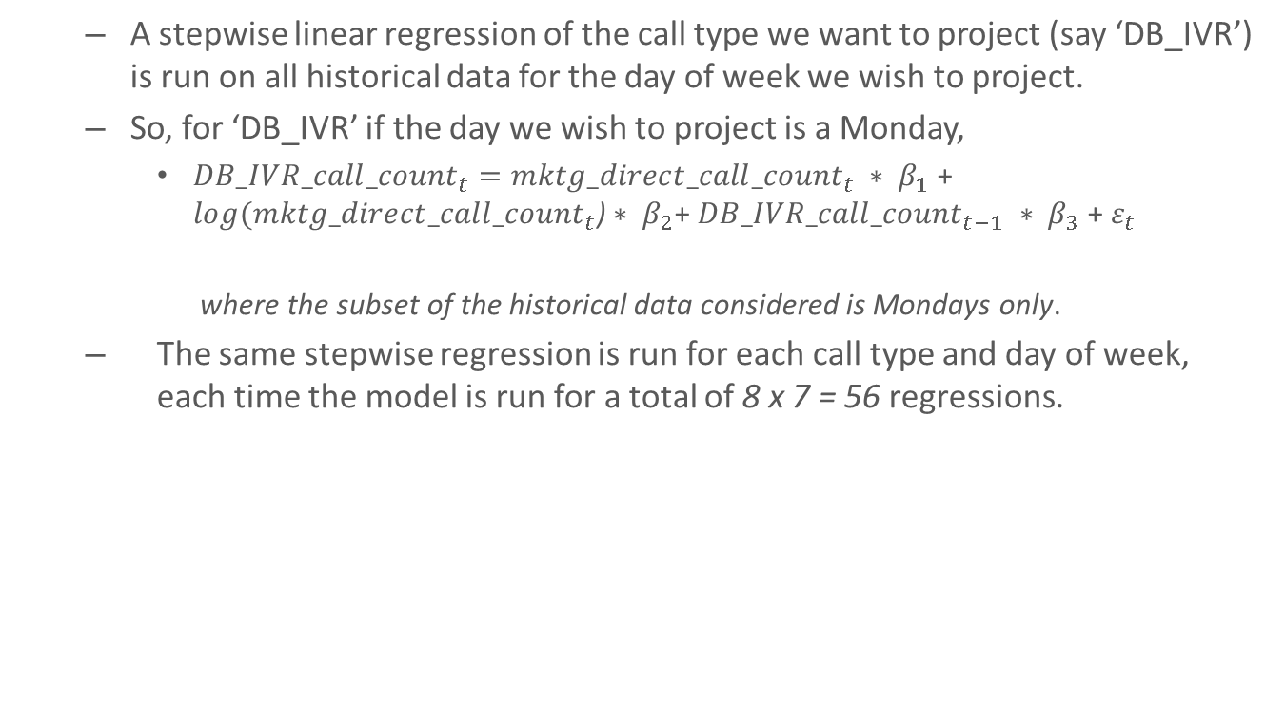
Call Model: All other Call Counts
A stepwise linear regression of the call type we want to project (say ‘DB_IVR’) is run on all historical data for the day of week we wish to project.
So, for ‘DB_IVR’ if the day we wish to project is a Monday,
${DB_IVR_call_count}_{t}={mktg_direct_call_count}_{t} ∗ β_{1}$ + $log({mktg_direct_call_count}_{t}\text{)}∗ β_{2}$+ ${DB_IVR_call_count}_{t−1} ∗ β_{3}$ + $ε_{t}$
where the subset of the historical data considered is Mondays only.
The same stepwise regression is run for each call type and day of week, each time the model is run for a total of 8 x 7 = 56 regressions.

Slide 7
Holiday Adjustments
Holidays are merged in from ‘time_and_date.com’ through 2019. I also added ‘Black Friday’ as a holiday as we historically experience a huge drop in call counts on the day after Thanksgiving, although it’s not an acutal holiday.
If the projection is a Holiday, then the finally call projections are normalized by the ratio of the average past number of calls on the Holiday relative to non-adjusted projections on the Holiday.

Slide 8
Controlling for Outliers
Using the past 12 weeks of data (past quarter) the model controls for potential projection outliers after all estimates are made.
‘mktg_direct’ call projections are windsorised at the 5th% and 95th% of lagged quarterly actuals.
All other categories are windsorised at the 25th% and 75th% of lagged quarterly actuals.
In addition, projections are adjusted by the average model Error over the last quarter on the same day of week (within a 5% bound).
These controls are only implemented on weekdays which are NOT holidays.

Slide 9
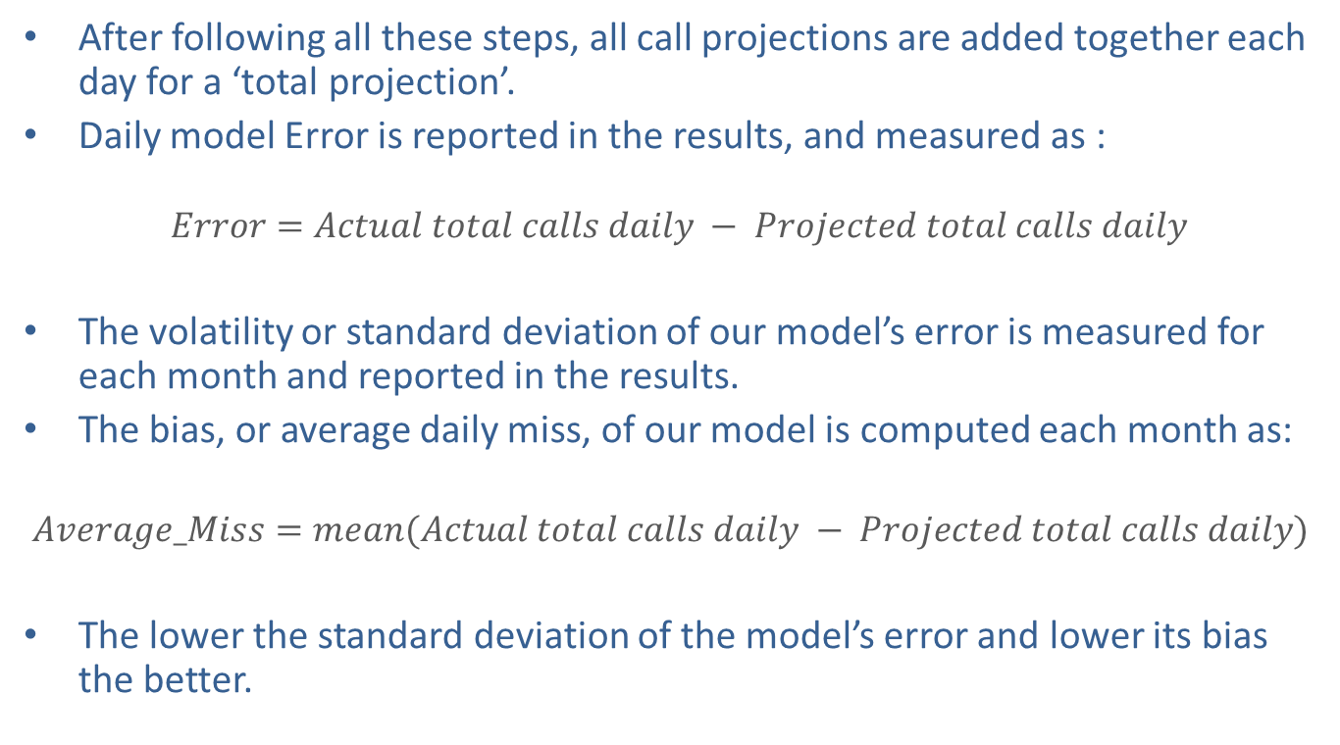
Total Call Projection Reported Statistics
After following all these steps, all call projections are added together each day for a ‘total projection’.
Daily model Error is reported in the results, and measured as :
$Error=Actual total calls daily − Projected total calls daily$
The volatility or standard deviation of our model’s error is measured for each month and reported in the results.
The bias, or average daily miss, of our model is computed each month as:
$$Average_Miss=mean(Actual total calls daily − Projected total calls daily)$$
The lower the standard deviation of the model’s error and lower its bias the better.

Slide 10
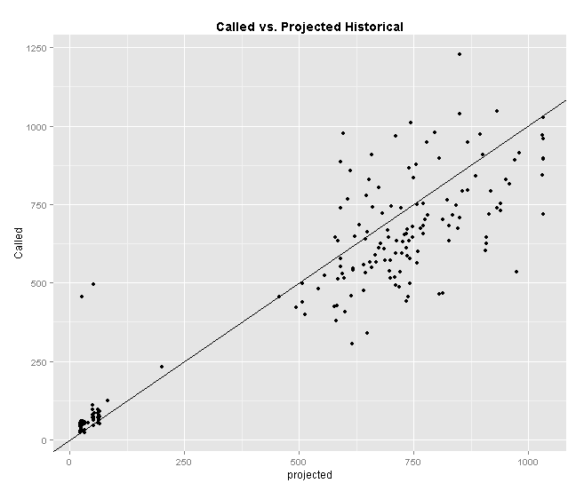
Model Performance: Mktg Direct Only
Daily call standard deviation between actual and projected of 137 calls
On average, overestimate mktg calls by 35 calls
~68% of days within 140 calls and ~95% of days correct within 280 calls
Call projections explain over 83% of the variance in daily calls (92% correlation)
Large outlier- a weekend in which testing was taking place

Slide 11
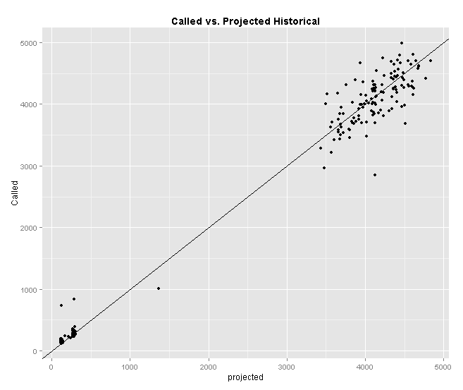
Model Performance: All Calls
Daily call standard deviation between actual and projected of 252 calls
On average, overestimate total calls by 14 calls
~68% of days within 250 calls and ~95% of days correct within 500 calls
Call projections explain over 98% of the variance in daily calls (99% correlation)
Day before Thanksgiving (largest outlier—historically has not been an unusual day)

Slide 12
Conclusions
Model can be used going forward to project mktg calls (as well as other categories) and total calls.
Historically, the model has done fairly well (99% correlation to actuals), however; this is still significant error on a day-to-day level and most of this comes from the mktg call projection.
Best opportunity to improve the model going forward is to further improve the logic to predict mktg calls (better fit RR curves to past data and incorporate relationship between mktg calls and lagged mktg calls).

